Slide 1

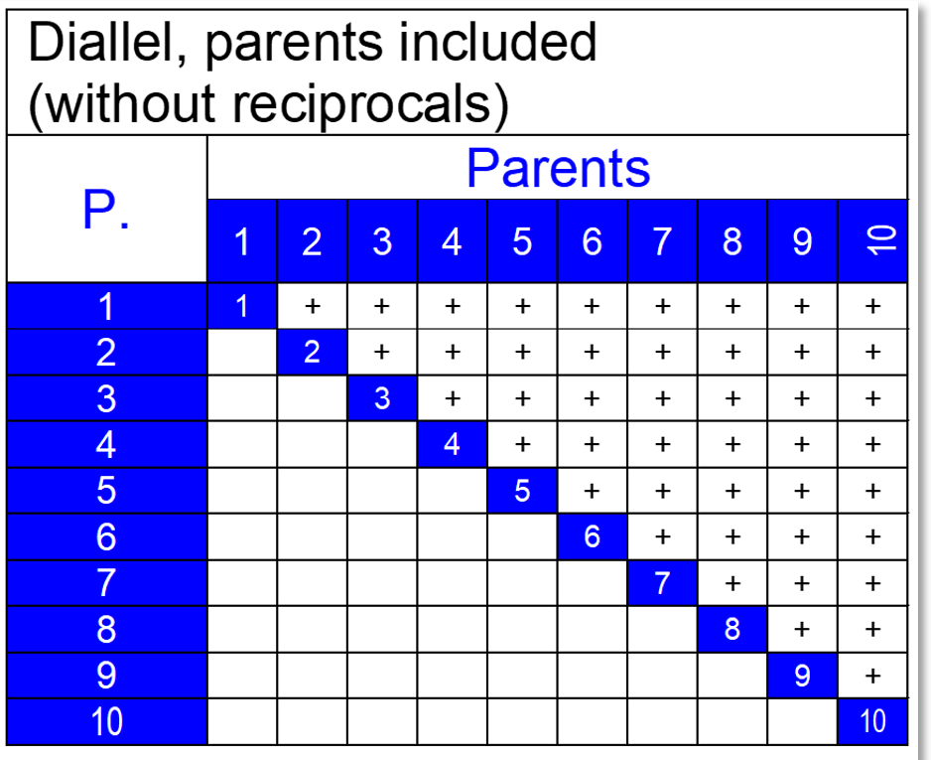
https://www.uni-goettingen.de/en/48115.html
UNPLAB-BrMeth_Ch-3[GCA I]
General Combining Ability aka GCA
1

Slide 2
Sequential Number: #21
UNPLAB-BrMeth_Ch-3[GCA I]
Unless I explicitly state otherwise, images and cartoons are created using ChatGPT.
You may use this material free of charge under the terms of the CC BY license. This requires that you provide appropriate attribution to the author: W. Link, University of Goettingen, Germany.
In a few cases, individual images, photographs, or similar material may be subject to a more restrictive Creative Commons license. Where this applies, it is explicitly indicated, and you must comply with the stated license terms for those items.
Please check the license information carefully before reuse. Responsibility for complying with the applicable license terms rests entirely with you.
2

Slide 3
You already know: Population Genetics, GxE, Heterosis, Inbreeding
Keywords of this chapter: GCA General Combining Ability; SCA Specific Combining Ability;
Topcross & Topcross-Test, Polycross & Polycross-Test; Tester, Choice of Tester
Algebra as introduced in this chapter:
One can write (linear model) the performance Y_{ij} of a hybrid F1_{ij} from its parents’ GCA-values plus the SCS-value of this actual pair-of-parents: Y_{ij} = µ + GCA_{i} + GCA_{j} + SCA_{ij}
3

Slide 4
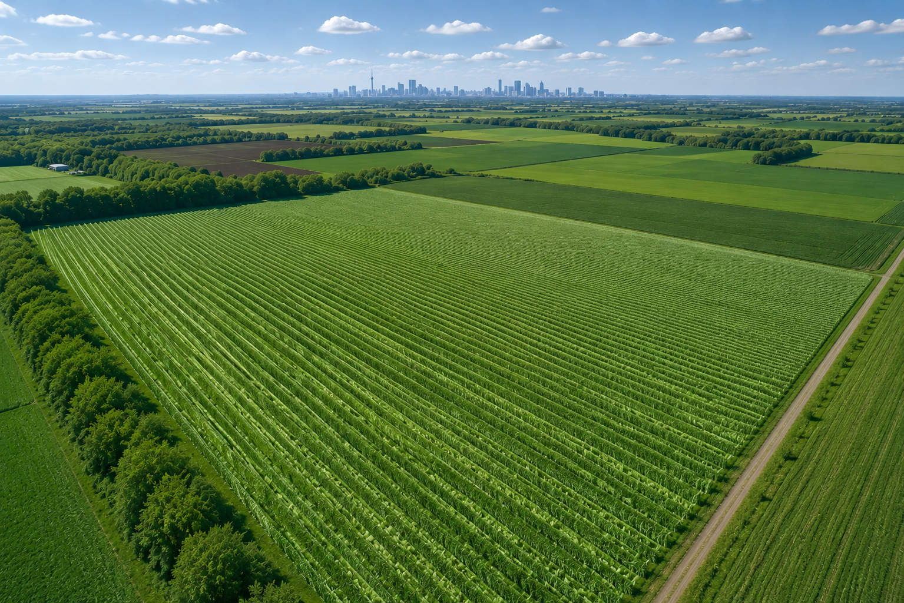
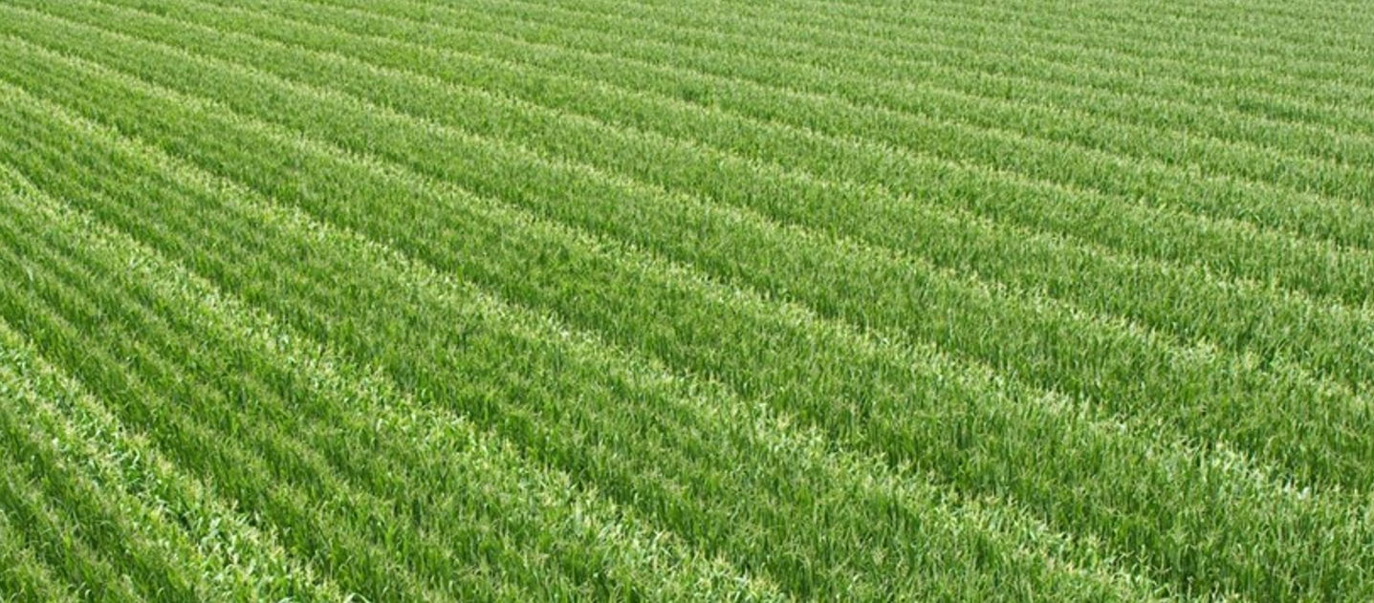

Slide 5
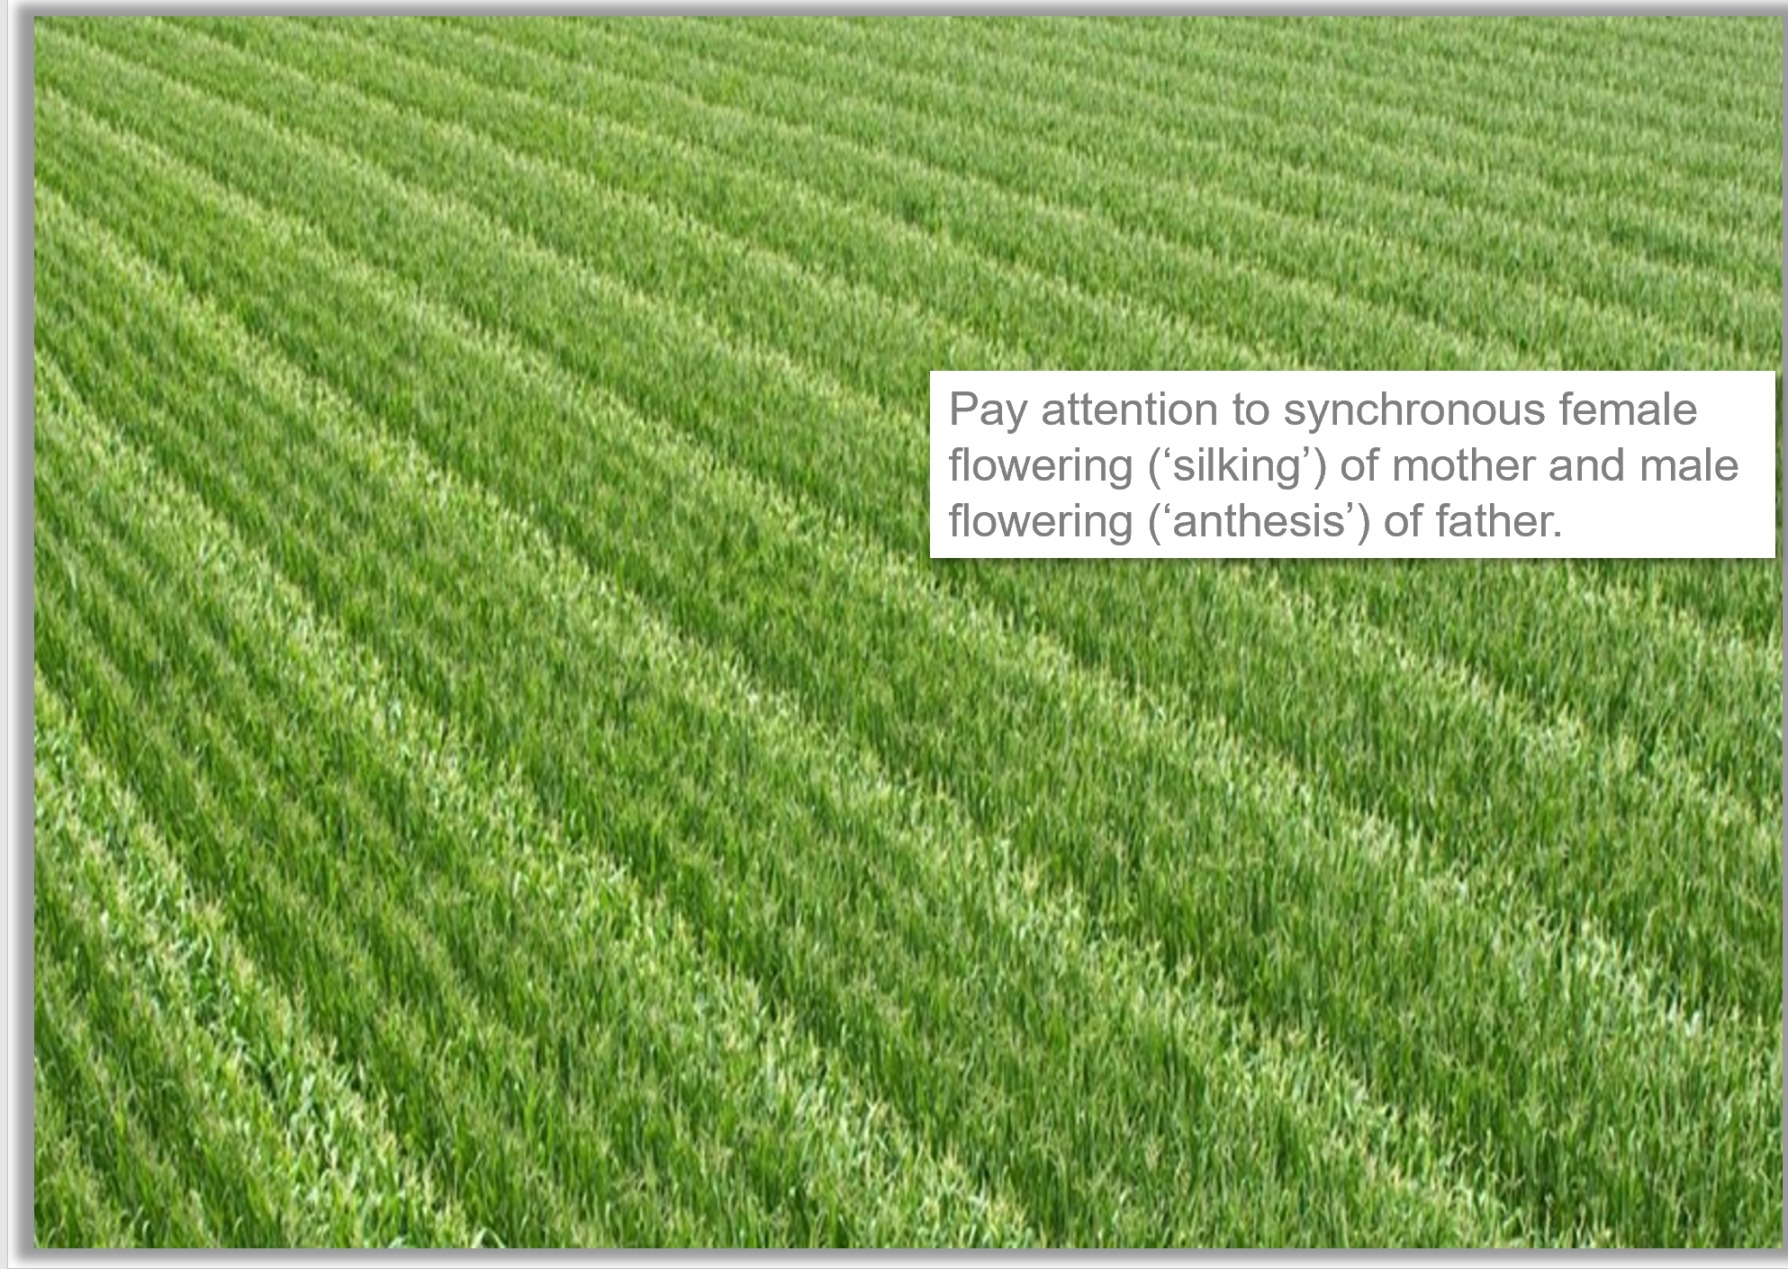
Appreciate the difference between hybrid Breeding and hybrid Seed Production
This is how a maize hybrid seed production field may look like. Four mother rows (seed parent; plants do not produce pollen) sown alternating with two father (pollen parent) rows. The father rows must be harvested separately to get purely the desired F1-seed (mother crossed with father) and avoid the ‘wrong’ seed (seed that grows on the father rows).
Maize, as wind-pollinator, produces enough pollen to allow more or less a full polli-nation and fertilization of a field even if the pollen-shed-ding plants are a minority. This is different in crops such as rice or wheat!
5

Slide 6
The picture is not necessarily hybrid seed production; maybe it shows a ‘Topcross’
6
Terms that we will now develop and use:
General combining ability (GCA)
Specific combining ability (SCA)
Breeding value (BV)
Candidate
Tester
Topcross
Polycross
Diallel cross, factorial
CMS, pollen sterility
Topcross:
With maize, it is easy to ensure that the four rows per candidate do not self-pollinate, but are only pollinated and fertilized by the common pollinator which is grown multiple times in two-row strips: This is achieved by removing the tassel (male organ) from the candidates, making them purely female.
The only pollen that is then available for them comes from the chosen, offered pollinator (that has remained female-plus-male).

Slide 7
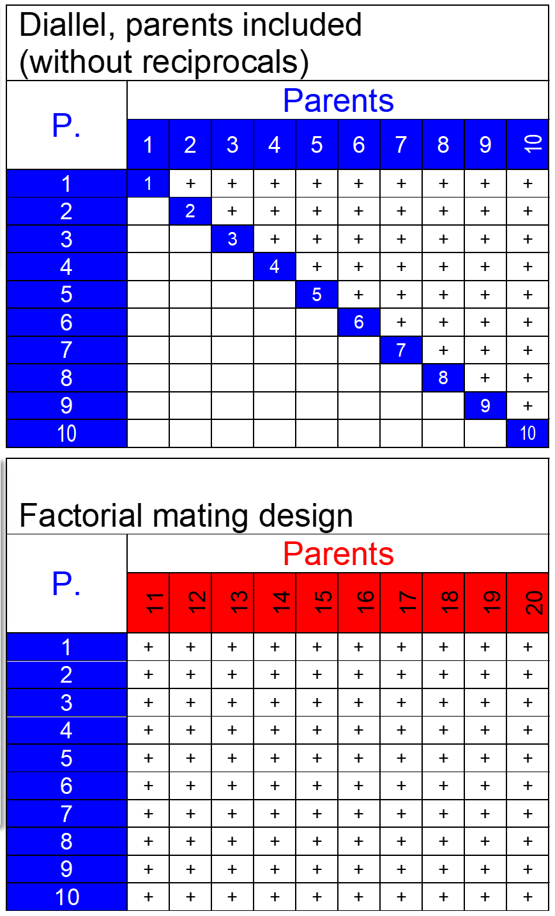
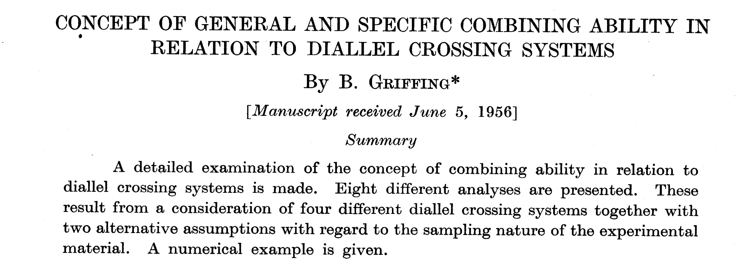
The so-called Diallel (cross design) and the Factorial (cross design) are famous Mating Designs. They are used to assess sets of inbred lines for General and Specific Combining Ability for agronomic perfor-mance (Allgemeine bzw. Spezifische Kombinations-fähigkeit).
https://www.publish.csiro.au/bi/pdf/BI9560463
7

Slide 8

The so-called Diallel (cross design) and the Factorial (cross design) are famous Mating Designs. They are used to assess sets of inbred lines for General (GCA) and Specific (SCA) Combining Ability for agronomic performance (Allgemeine bzw. Spezi-fische Kombinationsfähigkeit).
Why should we study these parameters?
Wait a little bit, until we come to
Prediction. Anticipation. Forecasting.
Fortune-telling ;-)
Then it should become clear that we can predict the performance of candidate genotypes mainly with GCA (and less with SCA), thus saving money and time: We will not invest in those candidates who - based on prediction - perform inferiorly. Either we save money or we can invest more in those who are predicted to perform superiorly.
8

Slide 9
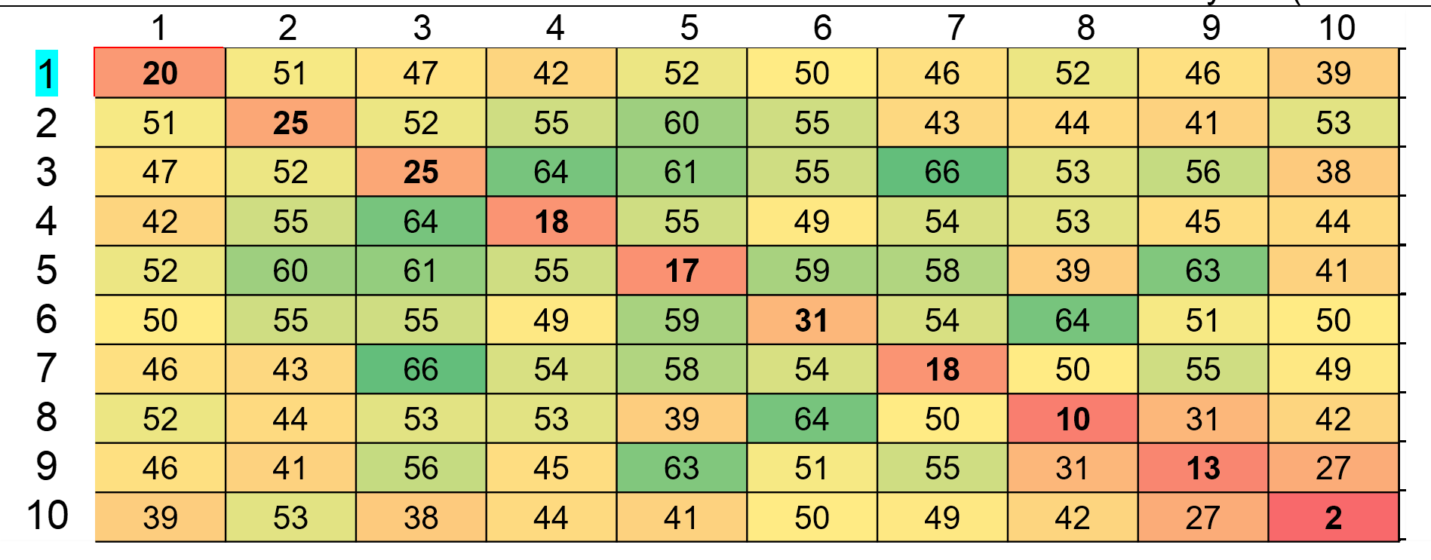
Sprague and Kinman 1945, J. Am. Soc. Agronomy 37, 341-351. A famous paper.
9
Parental inbred lines 1-10 and their diallel cross F1-hybrids. Data is grain yield (maize, bushels per acre)
Reciprocal results are identical because I used copy-past to have a ‘full’ table (true data is without any reciprocals).

Slide 10
10
The ‚Diallel‘ is a crossing scheme to analyze GCA and SCA of a set of inbred lines
1
-3.2251
The GCA-effect of an inbred line shows half of its so-called Breeding Value (simple genetics assumed, cf. UNPLAB-QuGen_Ch-6[StatMod I], page 24). GCA of parent 1 is the mean Deviation of all-of-its F1-hybrids with all-the-other lines from the Grand Mean (µ); 47.222-50.089 bushels per acre. Honestly speaking, here corrected by factor 9/8, to overcome the calamity with the diagonal; the diagonal genotypes are no F1-hybrids but are the lines ‘themselves’).

Slide 11
The ‚Diallel‘ is a crossing scheme to analyze GCA and SCA of a set of inbred lines
1
The GCA-effect of an
inbred line is half of its
so-called Breeding Value (simple genetics assumed); of course the Breeding ‘Value’ is scaled as effect (with minimum zero and mean µ); and is not a value
Effect: Deviation from mean.
Excluding complications such as epistasis, we find the so-called ‚Breeding Value, BV‘ of the hybrid F(1x2) as
∑GCA(1)+GCA(2) = (-3.225+0.400) = -2.825. This BV applies when using F(1x2) as parent to breed (cf. UNPLAB-QuGen_Ch-6[StatMod I]).
The inbred lines 1 and 2, being homozygous parents, have (and inherit) correspondingly these Breeding Values; BV(1)= 2 GCA(1) = -6.450; BV(2) =2 GCA(2) = +0.800; and so on.
The GCA effect of an inbred line is hence half of its Breeding Value.
The GCA-effect of the F1(1x2) is, correspondingly, BV[F1(1x2)] / 2 = -2.825/2 = -1.413.
This GCA is expected if we – just for fun – employed this F1 as parent number 11 and ignored its kinship here.
11

Slide 12
See the yield results (bushels/acre) of maize lines and their Diallel-cross F1-hybrids
We could re-con-struct (and even predict) values such as F1(1 x 2) = 51 q/acre from the general mean µ and the here-estimated GCA-effects of mother and father of that hybrid.
Such approach is sometimes seen as „explanation“ of the re-constructed data point.
F1(1 x 2) = µ + GCA(1) + GCA(2) + SCA(1x2) + error
F1(1 x 2) = µ + Breeding Value + D(1x2) + error*
51.0 = 50.089 + (-3.225) +(0.400) + 3.736 + error
51.0 = Mean + main effect(s) + ‘surprise’ (includes error)
SCA(1x2) = 51 - 50.089-(-3.225)-(+0.004)=3.736
Prediction is not perfect, otherwise SCA was zero.
*epistasis neglected
12

Slide 13
SCA-effects. Breeders usually prefer large GCA-effects and small SCA-effects. If SCA-effects were zero, then GCA-effects alone ‘explained’ F1-hybrid’ performance 
Nota bene: The SCA-effects sum up to zero in each column and each row (a typical feature of interaction terms)
F1(1 x 2) = µ + GCA(1) + GCA(2) + SCA(1x2) + error
F1(1 x 2) = µ + Breeding Value + D(1x2) + error
51.0 = 50.089 + (-3.225) +(0.400) + 3.736 + error
51.0 = Mean + main effect(s) + surprise (includes error)
SCA(1x2) = 51 - 50.089-(-3.225)-(+0.004)=3.736
13

Slide 14
SCA-effects. Breeders usually prefer large GCA-effects and small SCA-effects.
ANOVA shows that variance due to GCA-effects is markedly smaller than variance due to SCA-effects (15.2 < 46.2). Maybe inbred lines 8 and 9 are rela-ted (their SCA is negative and large), making their hybrid lower yielding than expected. Such violations of basic assumptions lead to biased conclusion.
14

Slide 15
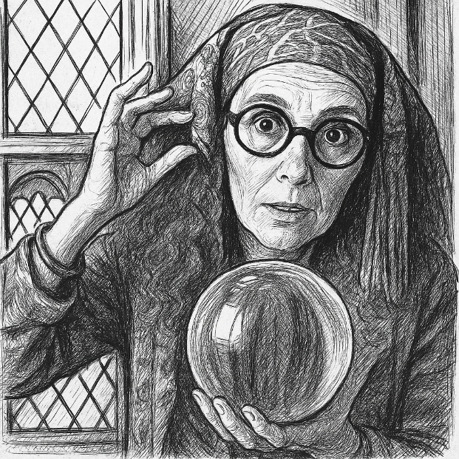
Prediction, anticipation, forecasting. Divination? Fortune-telling? Here we are now!
Agronomy in general and Plant Breeding in particular is highly depending on Prediction.
• Many types of fertilizer are tested with e.g. several cvs. of wheat, the best-rated fertilizers are marketed and applied to different wheats.
• Many types of pesticides are tested with e.g. several cvs. of canola, the best-rated ones are marketed and applied to other canola cvs.
• Many candidate inbred lines are tested as hybrid parent with several ‘tester lines’ as second parent. The best candidates are - then - used to produce experimental hybrid cvs. with different lines. You see the analogy. The GCA-data are main effects just like other main effects in a linear model. We tend to assume that such main effects ‚hold‘ and can be realized in new combinations (with other cultivars; with other fathers). That assumption is not fully valid, because specific interactions occur between fertilizers and cultivars, pesticides and cultivars, mother and father lines. Such interactions are the ‚surprise‘, the hard-to-predict part of the results. Hence, we prefer to have large main effects (GCA) and little interaction effects (SCA).
Anyway, all this is subject to the proviso that it must prove itself in new agro-ecological settings & environments; different from the ones when we tested and decided. Means here: Heritability of GCA and SCA is not 100%.
15

Slide 16
Prediction, anticipation, forecasting. What is this: ‘per se’ performance?
The average performance of all single cross hybrids from inbred line 1 is compared with the general mean of all hybrids. For line 1, e.g., it was lower (47.222<50.089). Hence, the General Combining Ability of inbred line 1 was negative (GCA1 = -3.225).
Being effects, the GCAs are on average zero and their sum is zero, too. The GCA effects of the inbred lines are usually markedly and significantly correlated to their per se performance (perfor-mance of the inbred lines themselves).
A first step of selection between inbred lines (focussing on hybrid breeding) is to select among them for features that are related to their seed- and pollen-parent rôle; in maize for instance an ade-quate cob placement. Moreover, low performing lines (per se) will be discarded due to the common-ly found correlation between yield per se and GCA-effects of yield (see diagram).
6
3
5
6
4
7
2
r=0.78**
4
b=0.39
2
0
GCA-effects of inbred lines
8
-2
1
9
-4
-6
10
-8
0
5
10
15
20
25
30
35
Per se performance of ten inbred lines
16

Slide 17
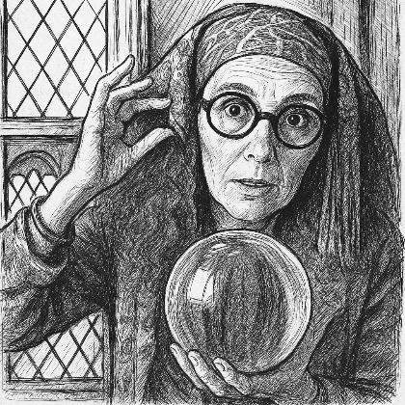
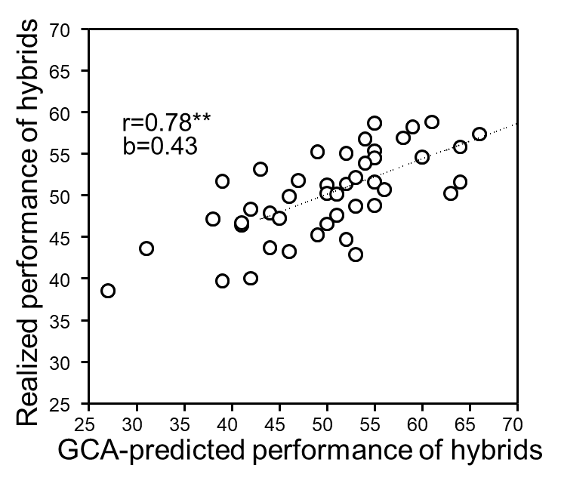
Prediction, anticipation, forecasting. Now employing estimates of GCA.
GCA-data can be acquired much cheaper than SCA-data!
See later in this chapter … Topcross and Topcross-Test; Polycross and Polycross-Test‘.
See the F1 (1x2) indicated with faint lines
GCA-data can be acquired much cheaper than SCA-data!
One can predict the performance Y_{ij} of a hybrid F1_{ij} from its parents’ GCA-values: Y_{ij}=µ+GCA_{i}+GCA_{j}.
Here, the correlation between GCA-predicted performance of hybrids and realized (‘true’) performance is high (r =0.78). Deviations are caused by the SCA-effect of these crosses (Specific Combining Ability; and of course by error, since heritability of GCA and SCA effects is h²<1).
To get rid of a large share of inferior candidate parents, we may select based on their GCA effects and neglect SCA effects. If we do not need SCA data, we may acquire GCA estimates much cheaper than via Diallel cross and Diallel test. Mind: It is very expensive to produce seed of all F1-hybrids individually and to test them individually in field trials.
17

Slide 18
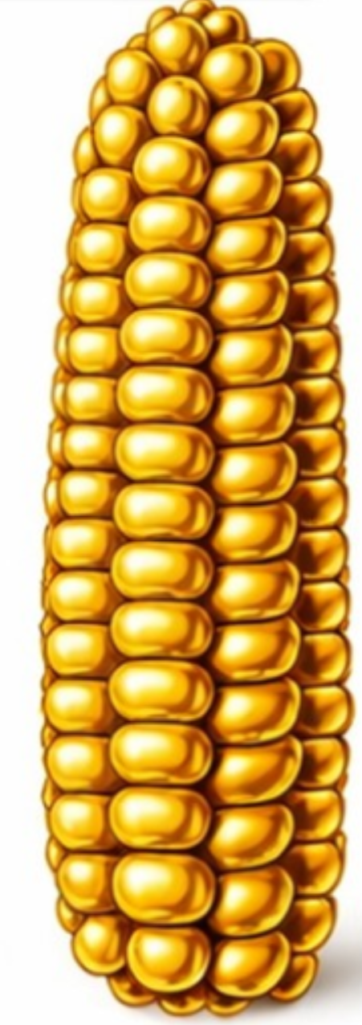
18
Prediction, anticipation, forecasting.
70
65
60
r=0.78**
55
b=0.43
50
Realized performance of hybrids
45
40
35
30
25
25
30
35
40
45
50
55
60
65
70
GCA-predicted performance of hybrids
What we ‘only’ need is the mean performance (47.222) of the nine hybrids with line 1 as common parent; and the mean performance (50.444) of the nine hybrids with line 2 as common parents; et cetera. We may produce these values (47.222, 50.444, etc.) by testing such nine hybrids as one mixture, as one entry of a field trial, assuming (in-deed an assumption) that the result of that mixture is nearly the same as the calculated means of such nine hybrids (after having field-tested them individually; in their pure stands instead of as one mixture).
The point is: Seed of mixtures of all hybrids which have one line in common as mother parent can be produced cheaply, much easier than producing the crosses individually (Diallel cross). How? “Just pollinate each line with an equi-dose mixture-of-pollen from the other lines; harvest the seed as mixture ready-to-sow”. ☺

Slide 19
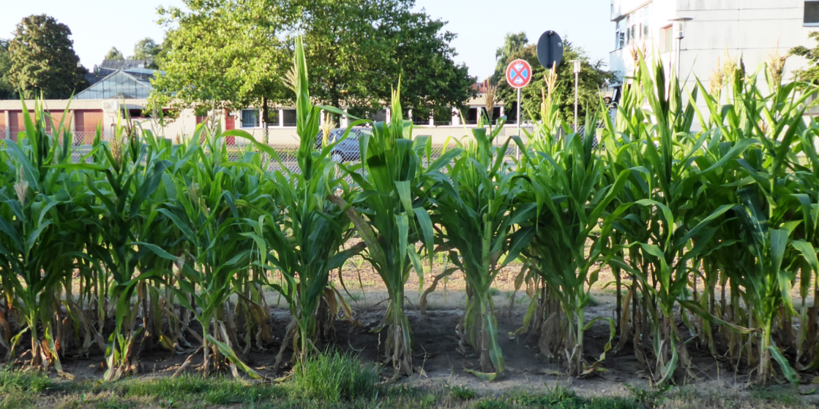
The Topcross - to acquire data for GCA-calculation much cheaper than via Diallel.
Pollinate each line with an equal dose mixture of pollen from the other lines, and when harvesting e.g. line 1, thus harvest the ready-mixed seed from hybrids F1(1x2) up to F1(1x9). Testing this mixed seed as one entry may give about the same result as assessing and calculating the average of these 9 hybrids from line 1 as common parent. And: Testing only one mixture as one entry is much less deman-ding than testing nine entries.
“Manually pollinate” ... “with an equal dose mixture of pollen” … ?! Oh no! We just rely on the random mating behaviour of maize (natural wind-pollination; no manual crossing). We just hope for equal male fertility of all lines, for synchronous flowering of all participants. This gives us the desired mixture without manual labour, cheap, very cheap!
The task left is just to prevent selfing of the seed-parent lines. Well. Emasculation in maize is easy ;-)
© Yaman
Mixture of 9 hybrids in one plot =-3.225
19

Slide 20

Although it may look different, but here, we are only talking about building blocks and puzzle pieces of breeding. This is not (yet) actual breeding.
The Diagram indicates features of Topcross and Topcross-Test
Entry=Candidate (Prüfglied, Prüfling, Kandidat)
Entry emas-
culated to procude hybrid seed
Wind-pollinated
Season 1
Topcross
Pollen ‘cloud‘ of tester
Season 2
Entry tested for GCA via offspring-test
Seed
Test offspring: Topcross-Test
© Yaman
Mind: Diagrams shows one plant of one candidate (entry). In reality, there are several plants per candidate and many candidates (and their very many offspring)
many candidates
20

Slide 21
Although it may look like, here we are only talking about building blocks and puzzle pieces of breeding: Not (yet) about the actual breeding of hybrid and synthetic cvs.
The Diagram indicates features of Topcross and Topcross-Test
Entry=Candidate (Prüfglied, Prüfling, Kandidat)
Here, the pollinator is the ‘tester’. In different settings, the tester might be female and the candidates might be employed as males.
If the pollinator (tester) is an equi-dose mixture of the candidates (entries), then such Topcross is genetically very alike to the correspond-ding ‚Polycross‘.
Yet, in a Polycross, the entries need not (are not) emasculated; fertilization management then relies on the reproductive peculiarities of the germplasm; such as self-(in)compatibility.
Entry emas-
culated to procude hybrid seed
Wind-pollinated
Season 1
Topcross
Pollen ‘cloud‘ of tester
Season 2
Entry tested for GCA via offspring-test
Seed
Test offspring: Topcross-Test
Mind: Diagrams shows one plant of one candidate. In reality, there are several plants per candidate and many candidates (and their many offspring)
21

Slide 22
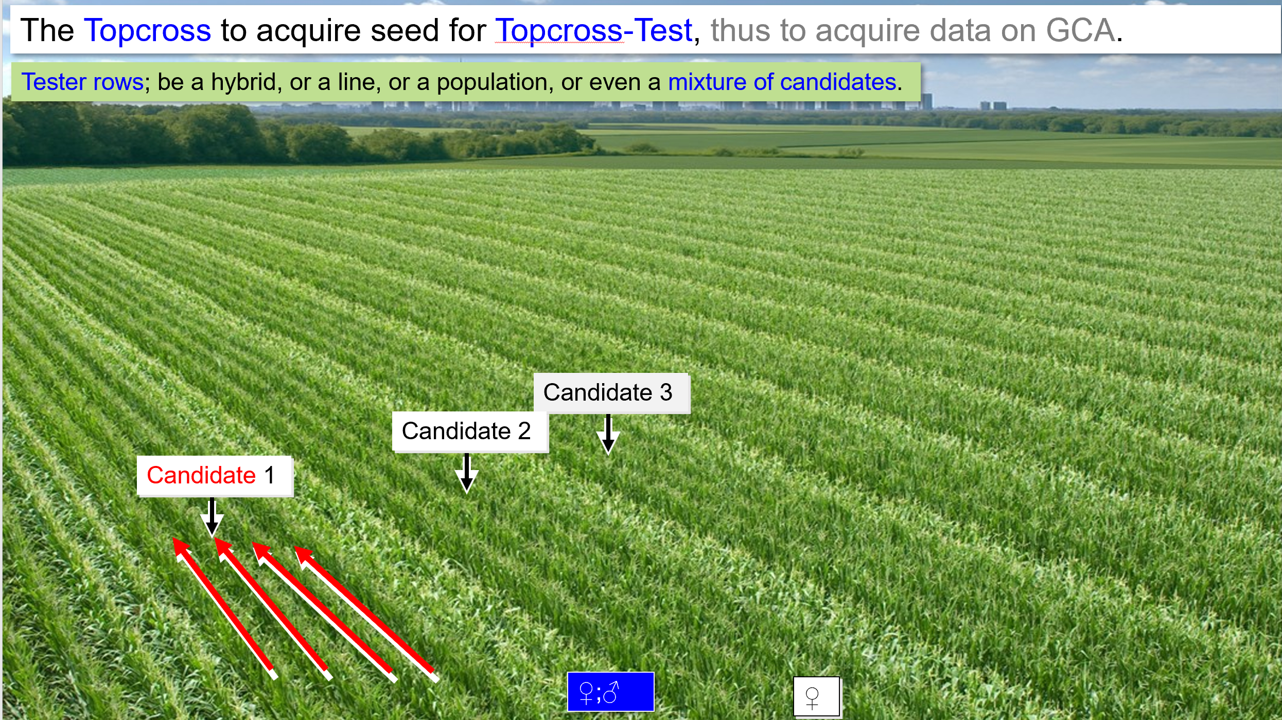
Candidates are typically more or less advanced inbred lines; need emasculation. The tester typically belongs to a different ‘heterotic’ germplasm pool, hence such Topcross’ focus is on GCA-effects towards an ‘other’ pool instead of towards ‘own’ gene pool.
Again: GCA-effects of homo-zygous candidates are ~½ of their Breeding Value.
The phenotypically (via field trials) assessed GCA effects and Breeding Values are con-trasted and complemented with the so-called Genomically Estimated Breeding Values (see later; Genomic Selec-tion; UNPLAB-BrMeth_Ch-11[TheFour GS]).
♀;♂
♀

Slide 23
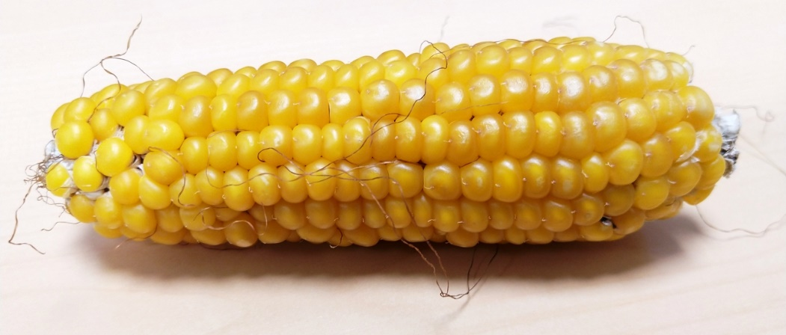
Predict the performance of F1-hybrids from GCA-effect of mother & father line.
70
If we actually only produced seed to test the 22 superior (based on pre-diction) F1-hybrids, most of them (17 of 22) belonged to the really-better group (y-axis).
Five superior hybrids would not be tested, we would have missed them, though.
What if the tester (pollinator in Topcross) was one of the 10 lines instead of being an equi-dose mixture of all 10 lines?
The correlations r between the GCA-effects that resulted in this case and the ‚true‘ GCA-effects from the 10x10 Diallel varied from 0.304 < r < 0.883. Lowest r if line 6 served as sole pollinator, highest r if line 9 was the only pollinator. The average correlation (ten lines) was r=0.573. Here, even the correlation between per se performance and ‚true‘ GCA effects (r=0.781) would be higher. Obviously, estimating GCA in this way is not the best option. What disturbs are always the SCA-effects towards that one line; they blur the results (the SCA-effects of ten lines, are, on average, zero ;-).
65
60
r=0.78**
55
b=0.43
50
Realized performance of hybrids
45
40
35
30
25
25
30
35
40
45
50
55
60
65
70
GCA-predicted performance of hybrids
© WL
23

Slide 24
Choice of tester. One line or one hybrid as tester.
70
65
60
r=0.78**
55
b=0.43
50
Realized performance of hybrids
45
40
35
30
25
25
30
35
40
45
50
55
60
65
70
If pollinator (tester) was a hybrid, e.g F1(1x2) or F1(3x4) ..?
GCA-predicted performance of hybrids
Would these results give a better indication of the ‘true’ GCA effects? With e.g. F1(1x2) as tester: r=0.615. With F2(3x4) as tester: r=0.841. Two lines are incorporated in one such F1. Mean of ‘SCA with line 1 and SCA with line 2’ applies (or mean ‘SCA with line 3 and line 4’, etc.). This makes SCA impact smaller (SCA variance halved), thence the correlation to ‘true’ GCA is higher). Nota bene: GCA of pollinator (tester) does not blur, since this is a constant figure, a constant figure added to data does not change correlation.
What if the tester was an equi-dose mixture of the ten lines? Then - again: SCA effects fully cancel each other.
! Hm … hm … this is if the 10 lines are the Reference. If a Basic Pool is the reference, then 10 lines are still only a sample and the mean of their SCA-effects with any candidate is not exactly zero. Hm hm …
24

Slide 25
Choice of tester. One line or one hybrid as tester.
70
65
60
r=0.78**
55
b=0.43
50
Realized performance of hybrids
45
40
35
30
25
25
30
35
40
45
50
55
60
65
70
If pollinator (tester) was a hybrid, e.g F1(1x2) or F1(3x4) ..?
GCA-predicted performance of hybrids
Would these results give a better indication of the ‘true’ GCA effects? With e.g. F1(1x2) as tester: r=0.615. With F2(3x4) as tester: r=0.841. Two lines are incorporated in one such F1. Mean of ‘SCA with line 1 and SCA with line 2’ applies (or mean ‘SCA with line 3 and line 4’, etc.). This makes SCA impact smaller (SCA variance halved), thence the correlation to ‘true’ GCA is higher). Nota bene: GCA of pollinator (tester) does not blur, since this is a constant figure, a constant figure added to data does not change correlation.
!Yet, it is still a difference whether we have but one plot for one GCA effects (9 hybrids grow mixed inside this plot) instead of 9 plots (9 single hybrids) per GCA-effect. One plot with the nine-hybrids-mixture carries its single-plot error, whereas the average from nine plots carries only 1/9 of a single plot error, hence, data is more precise.
25

Slide 26
Jump from
Topcross and Topcross-Test
to
Polycross and Polycross-Test
26

Slide 27
Polycross. Ten candidates, 3 replicates. Usually more candidates and more replicates.
First replicate
Second replicate
Third replicate …
Candidates are inbred lines or clones.
Polycross: To analyze GCA when testing Polycross-offspring. Approximate random mating is aspired. At harvest, seed from all plants (across replicates) of each candidate is joined to test (next season) the Polycross-Offspring from the candidates; the results of this Polycross-Test then allows to calculate GCA-effects of the candidates.
https://s.gwdg.de/r5uDAL 2008. Pp. 235-254.
27

Slide 28
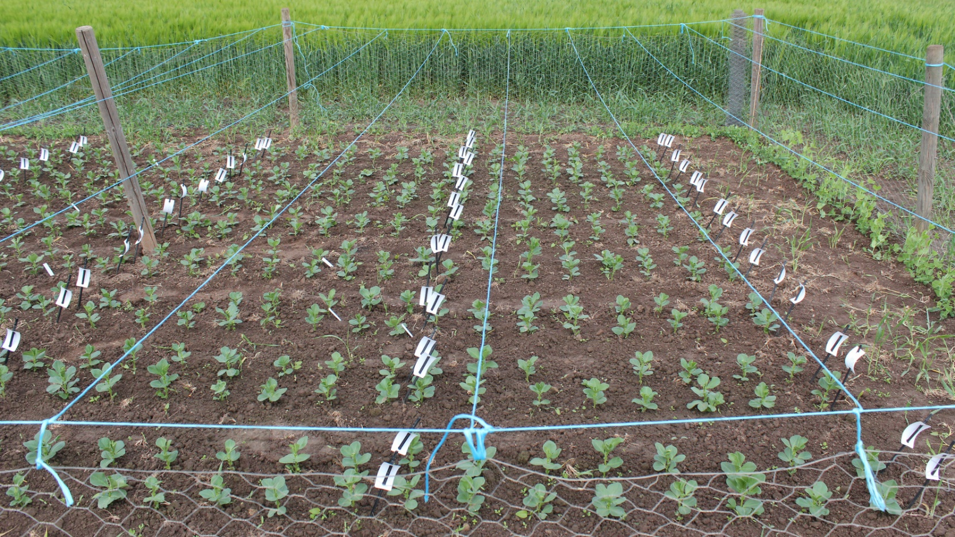
Polycross design with complete neighbour ba-lance. Morgan, J.P., 1988. Euphytica 39, 59-63.
© L. Brünjes
Mind: At maturity, seed from all individuals of candidate 1 have to be harvested and joined (to allow testing or this candidate’s offspring); not easy because of the randomization. Same for all other candidates ... !
Depending on insect- or wind-pollination and further peculiarities, one may want to have complete neighbour balance to allow each candidate genotype to have the same opportunity to be pollinated by any other of the member candidates of the polycross; to imitate random mating; to test all candidates for their GCA to this panel of candidates.
28

Slide 29
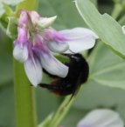
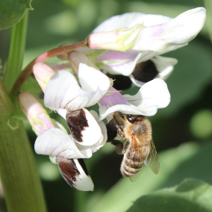
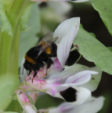
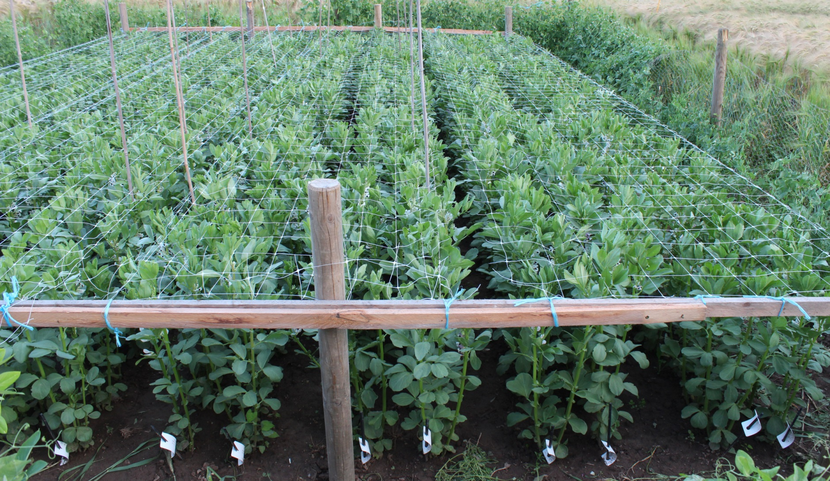
Polycross. Pollinators of Vicia faba are honey bees and bumble bees.
Photo is from the PhD project of Lisa Brünjes, cf. DOI 10.1007/s00122-021-03832-z.
This small winter faba bean Poly-cross was not conducted to assess the performance of the Polycross-Offspring from the eight inbred lines which were organized here as Poly-cross (and to calculate GCA from the data of that next generation).
But instead, the offspring from the eight lines were used to analyse the amount of cross- and self-fertilization of the 8 inbred lines, and to check whether they were differently effi-cient in being father for this Poly-cross (in siring the other seven in-bred lines with the aid of the pollina-tors). Significant deviations from all-is-equal expectations were indeed found.
© L. Brünjes & B. Marzinzig
29
29

Slide 30
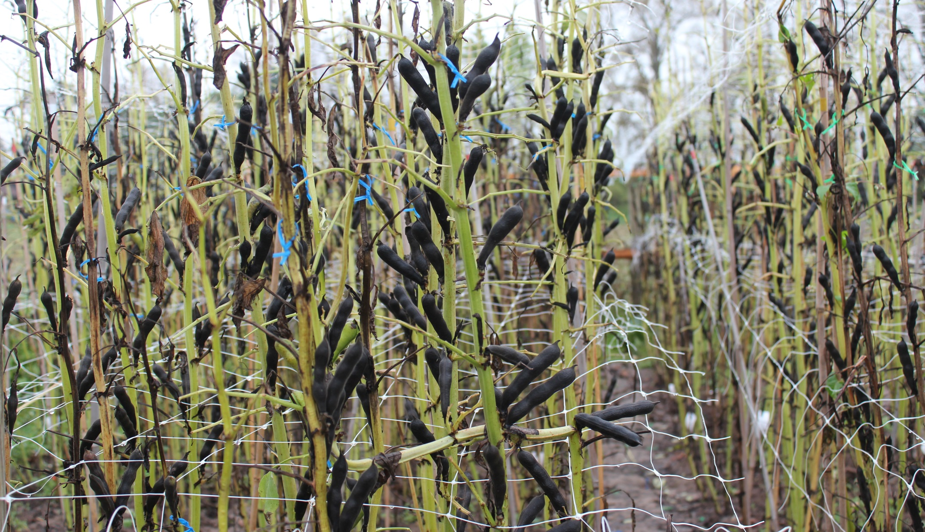
Rehearsal.
© L. Brünjes
Mind the difference between
►Topcross and ► Topcross-Test
► Polycross and ► Polycross-Test
Entries in Topcross and Polycross are lines or clones; such entries can be maintained without genetic change!
Entries in a Topcross-Test are Topcross-Progenies
Entries in a Polycross-Test are Polycross-Progenies
Testing Polycross-Progenies allows to estimate which effects? … GCA_{i}
Testing Topcross-Progenies allows to estimate which effects, if …
the tester is pure line i … [GCA_{i} plus SCA_{i,t}]
the tester is a hybrid … … … … … …
the tester is a mixture of the candidates … GCA_{i}
the tester represents (1) the same gene-pool as the
candidates, or (2) a different gene-pool … … … …
30

Slide 31
A Topcross ...
that uses an equi-dose mixture of the candidates as tester
is genetically equivalent to a ...
Polycross
31

Slide 32
From here you may go to UNPLAB-BrMeth_Ch-4[GCA II]
32

